Slide 1
Daily routines
Синельникова В.В., учитель
Харківської гімназії №6 “Маріїнська гімназія”,
спеціаліст вищої категорії, учитель-методист

Slide 2
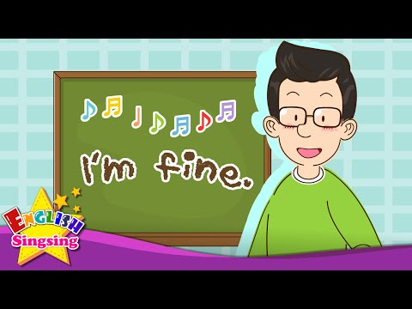
Good morning, boys and girls!
How are you?

Slide 3
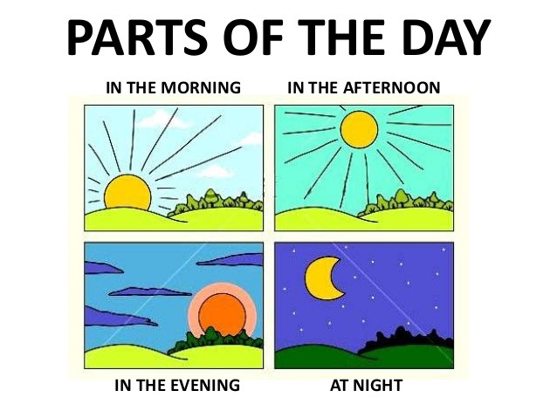
Can you name parts of the day?
Good
job!

Slide 4
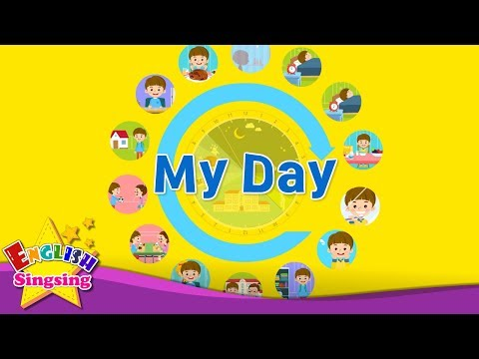
What do you do every day? Listen and repeat.

Slide 5
Read and match

Slide 6
Check yourself

Slide 7
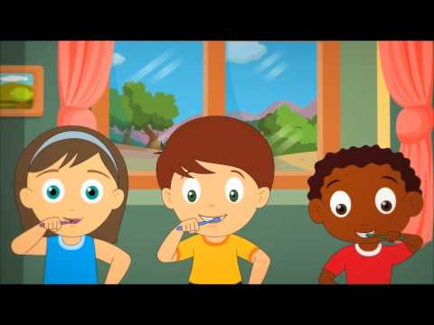
Sing with us

Slide 8
Activity 1
Match them up!
Listen to the song and make sentences.
This is the way we brush our clothes.
This is the way we wash our hair.
This is the way we comb our teeth.
This is the way we put on our face.

Slide 9
Check yourself
This is the way we brush our clothes.
This is the way we wash our hair.
This is the way we comb our teeth.
This is the way we put on our face.
Well done!

Slide 10
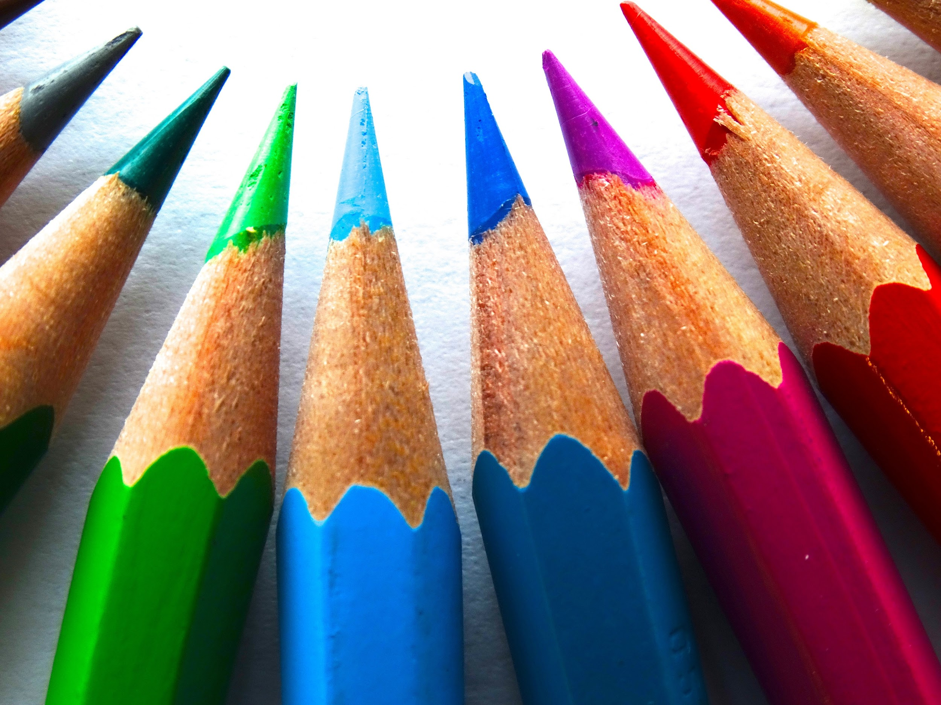
Activity 2 Write and draw!
What else do you do in the morning? Think of another action and draw a
picture. Then complete the new verse with your action and sing!
This is the way we ................................................
................................................, ................................................
This is the way we ................................................
on a warm and sunny morning.

Slide 11
Write about your day
Use the words from the video
I get up
I wash
I do
I have
I dress
I go

Slide 12
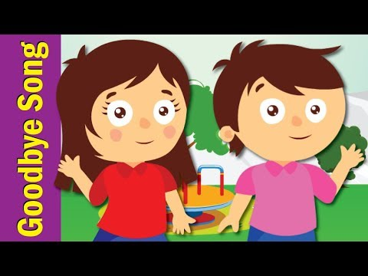
Goodbye, boys and girls!

